Slide 1
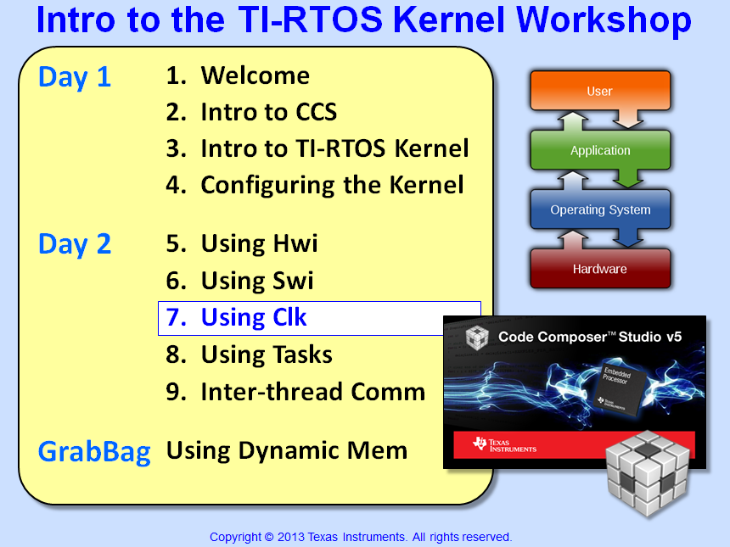


Slide 2
Objectives
Describe how to configure Clock Functions to execute periodically
Use Timestamp to benchmark code
Review basic debug tools and UIA
Lab 7 – Add Clock Fxn and use Timestamp to provide benchmarking

Slide 3
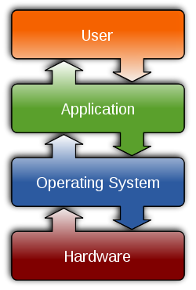
Outline
Clock Functions
Clock Module
Clock Functions
Timestamp
BIOS – Timer/Clock Usage
Lab

Slide 4
Outline
Clock Functions
Clock Module
Clock Functions
Timestamp
BIOS – Timer/Clock Usage
Lab

Slide 5
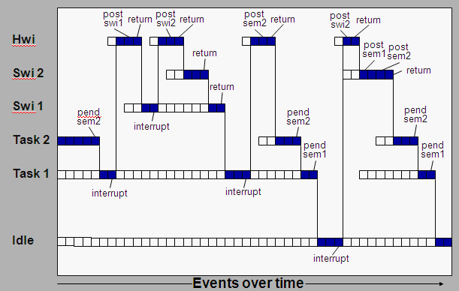
Time Can be an Event
What kinds of events cause these threads to run?
Can “time” be an event?
Which hardware peripheral would you use?
How do you configure a function to run at a periodic rate?
SYS/BIOS offers Clock services to set up periodic functions...

Slide 6
Clock Module
app.cfg
Priority
Time Base
Timer #
Tick rate (uS)
Clock Swi
HW Timer, ISR
Launch any “ready to run” Clock Fxns
Tick
Clock_tick()
Timeout tick rate
Makes setting up a hardware timer very simple – user specifies tick rate* (uS) – Clock module programs Timer, Hwi, ISR and Swi
Allows user to create different event rates from a single timer
User can choose time base – timer or app calls Clock_tick()
Explicit call of Clock_tick() could occur from your own ISR (GPIO, etc.)
Clock Swi launches periodic functions after N ticks (details coming up…)
*Hint: choose a tick rate that minimize # INTs (least common multiple)
How do you configure the Clock Module?

Slide 7
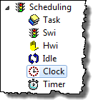

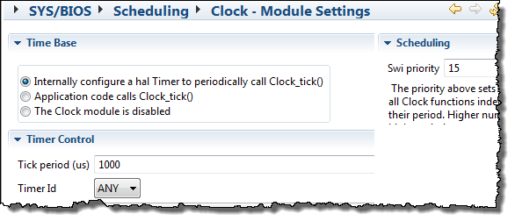
Configuring the Clock Module (GUI)
1
Use Clock (Available Products)
2
Configure Clock – Clock Input, Tick period, Timer, Swi priority:
app.cfg
Priority
Time Base
Timer #
Tick rate (uS)
Note: Tiva/MSP430 users can also suppress clock tick interrupts to save power and/or stay in sleep mode

Slide 8
Outline
Clock Functions
Clock Module
Clock Functions
Timestamp
BIOS – Timer/Clock Usage
Lab

Slide 9
Clock Functions
For each Clock Function, user specifies function to run and # ticks between runs (period)
“Tick” launches Clock Swi which compares running “tick count” with “period” to determine if each fxn should run:
Clock Swi
Clock Fxn 2
Clk Fxn 1
void doThis()
{
CheckUsr();
doAlgo();
}
Tick
Clk Fxn 2
Clk Fxn n
Clock Functions must complete within one System Tick
Break long functions into multiple threads (if needed)
How do you configure a Clock Function?

Slide 10

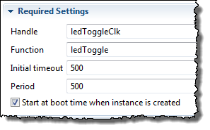
Configuring a Clock Fxn – Statically via GUI
Example:
Trigger ledToggle() every 500 ticks
1
Insert new Clock Fxn (Outline View)
2
Configure Clock Fxn – Object name, function, init timeout, period:
For “one-shot”, set initial
timeout to”value”, then
set period = 0
To START the Clock Fxn at runtime, check this box

Slide 11
Outline
Clock Functions
Clock Module
Clock Functions
Timestamp
BIOS – Timer/Clock Usage
Lab

Slide 12
Timestamp – Benchmarking Code
How do you benchmark code in real time?
Use the Timestamp Module
(C6000)
TSCH/L
Timestamp
(MCU)
Timer
C6000 devices use Timestamp Counter Hi/Lo (64 bit)
Other devices typically use a system timer as input
Use the following APIs to take a snapshot of time or freq:
Time (CPU cycles)
CPU Frequency (Hz)
uint32_t start, stop, result;
start = Timestamp_get32();
myAlgo(x,y,z);
stop = Timestamp_get32();
result = stop – start;
Types_FreqHz timestampFreq;
Timestamp_getFreq(&timestampFreq);
// returns timestampFreq.lo in Hz
What if myAlgo gets pre-empted?
Note: rollover handled by 2’s complement math
Which h/w Timers are used for Clock and Timestamp for each architecture?
Notes:
Rollover handled.

Slide 13
Outline
Clock Functions
Clock Module
Clock Functions
Timestamp
BIOS – Timer/Clock Usage
Lab

Slide 14
SYS/BIOS – Timer Usage
BIOS adds implicit Clock/Timestamp services to every .cfg file.
System Ticks are used for TIMEOUTs on blocking calls – e.g.
Semaphore_pend (Sem, timeout);
Let’s take a look at the timers/clocks used by BIOS:
Service | C28x | C6000 | MSP430 | TM4C
Clock (default Clk) | Timer 1 | Timer 0 | Timer A0 | Timer 0
TimeStamp (default Clk) | Timer 2 | TSCL/H | Timer A0 | Timer 1
Combined by Default ? | N | N | Y | N
User Combine? | Y | N | Y | Y
Modify Clk Src ? | Y | Y | Y | Y
Default Clk Rate | CPU | CPU | 32kHz | CPU
Note: MSP430 Timer-A0 defaults to ACLK (32KHz), can be changed to MCLK (CPU)
Notes:
Rollover handled.

Slide 15
Outline
Clock Functions
Clock Module
Clock Functions
Timestamp
BIOS – Timer/Clock Usage
Lab

Slide 16

Labs 5-9 “Roadmap”
Lab | Trigger | Hwi | Other | Fxn
5 | h/w timer | BIOS Hwi ledToggle
5B | BIOS timer ledToggle (Hwi)
6 | h/w timer | BIOS Hwi | BIOS Swi ledToggle
7 | BIOS Clock ledToggle (Hwi, Swi)
8 | h/w timer | BIOS Hwi | BIOS Task ledToggle
9 | h/w timer | BIOS Hwi | LED State → Mbx/Que →ledToggle

Slide 17
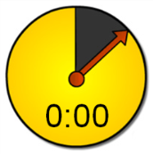
Lab 7 – “Blink LED” Using Clock
Lab Goal:
Instead of toggling the LED in a Swi, the Clock module contains the trigger (timer), Hwi and Swi
Procedure
Import archived (.zip) project
Add Clock object (for ledToggle)
Remove Timer, Hwi, Swi !!
Build, “Play”, Debug
Use TimeStamp/UIA to benchmark your code
Lots of TIME calculations regarding LED toggle
Everything is done “inside” the BIOS Scheduler
main.c
main() {
init_hw();
//Timer (500ms)
BIOS_start();
}
Clock
ledToggle() {
toggle(LED);
Log_info();
}
Idle
Clock
Hwi
Clock
Swi
Tick
BIOS Scheduler
Time: 45 min

Slide 18
Lab 7 – Benchmarks
 | C28x | C6000 | MSP430 | TM4C
CPU Frequency | 90 MHz | 300 MHz | 8.192 MHz | 40 MHz
LED/GPIO (hardware toggle) | 3 | 70 | 71 | 12
+Swi and Fxn overhead (lab 6) | 990 | 433 | 1800 | 520
+ Clock overhead (lab 7) | 1892 | 758 | 3516 | 720
All benchmarks shown in CPU cycles
All used Debug build configuration – no optimization turned on
All measurements taken in Exec Graph (or Log results) and then converted to CPU cycles
Swi includes ledToggle() code + Swi context save/restore + toggling LED
Clock overhead includes ledToggle() code, Hwi/Swi context save/restore + toggling LED

Slide 19


Slide 20
Outline
MainHighlight
MainNormal
SubHighlight
SubNormal

